Slide 1
資料科學導論期末報告
降維工具實作 - 以基因表現量資料為例
組名: 科科
組員: 生科110 林耿弘
生科110 周治瑗
生科110 蔡秉勳

Slide 2
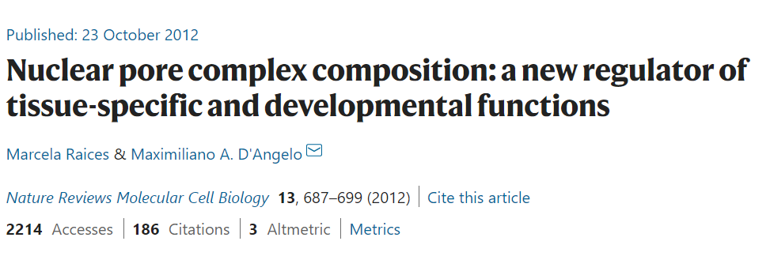
Motivations
UMAP
生物資訊常見的降維工具: t-SNE and UMAP
Nuclear pore complexes (NPCs)

Slide 3
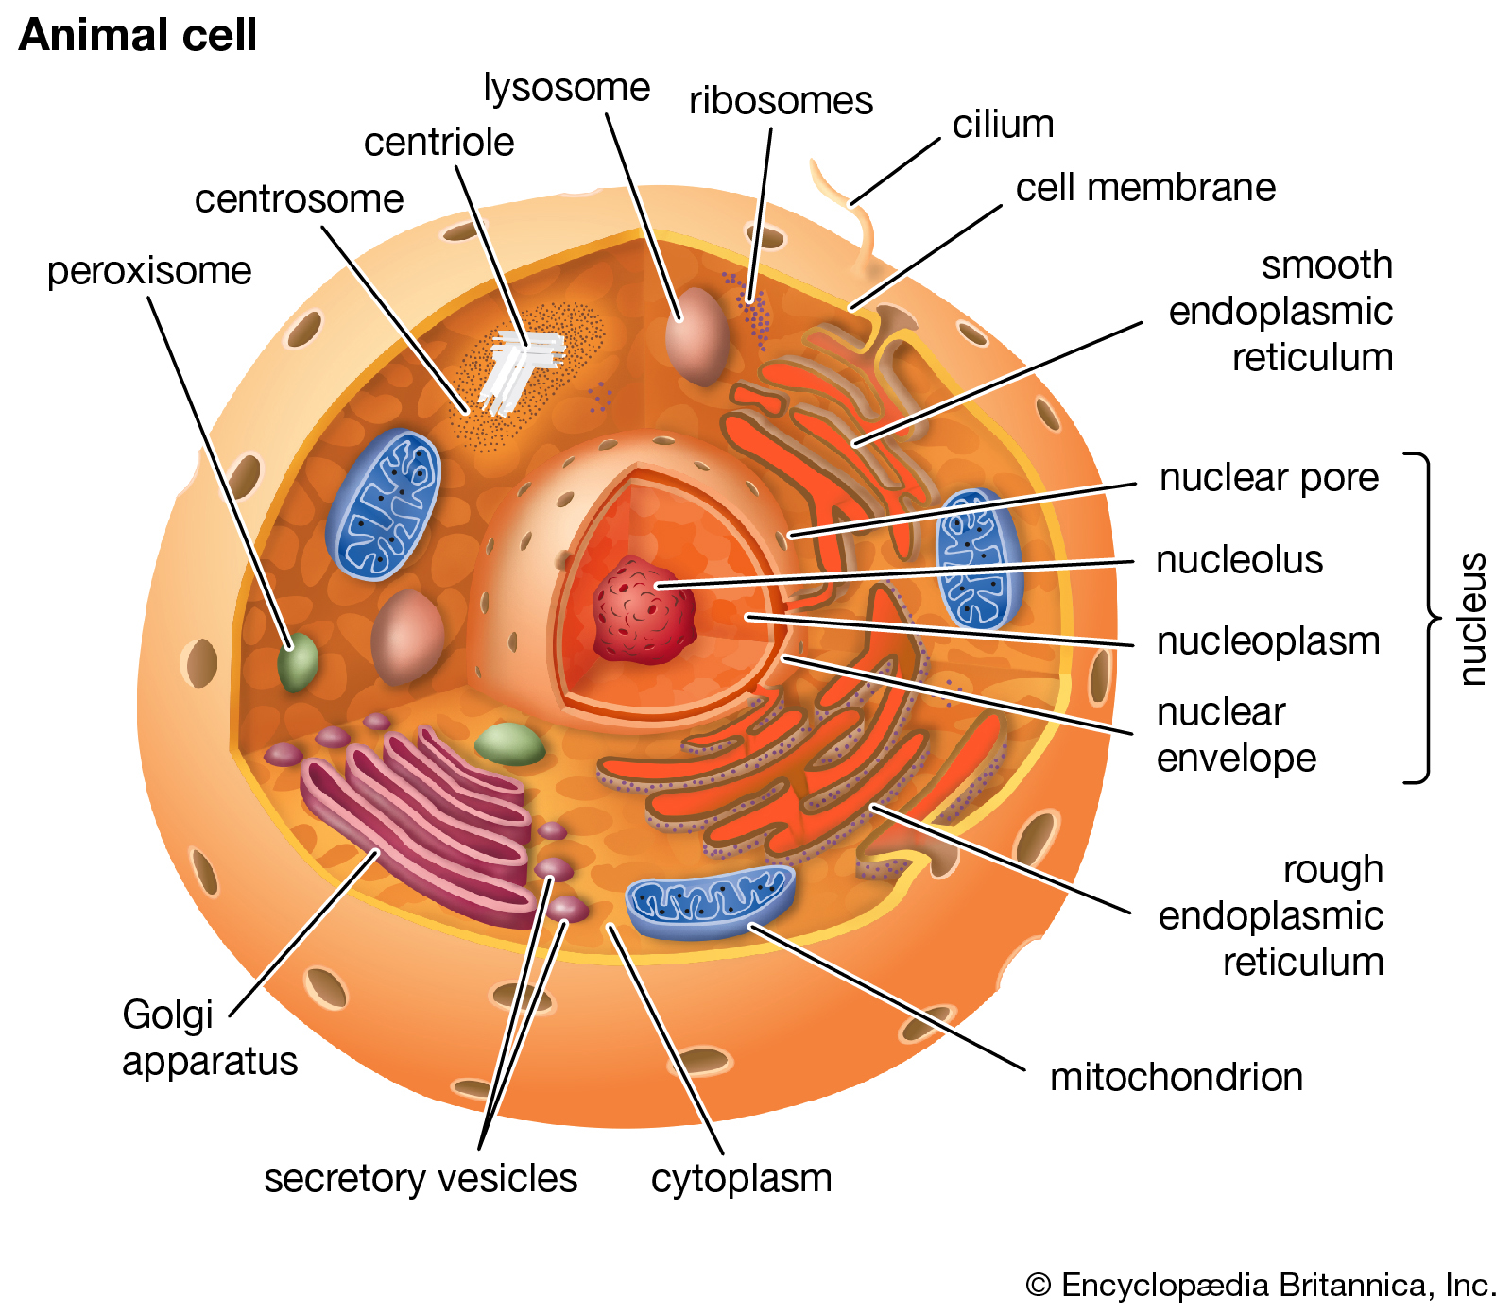
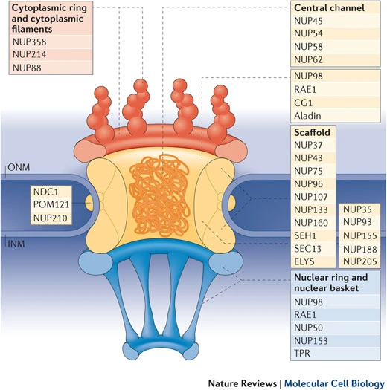
Problem Statement
Are nuclear pore complexes (NPCs) tissue-specific?
Input: gene expression of different tissues data
Output: UMAP 2D scatter plot
sample1(gene1, gene2…, gene31)
sample2(gene1, gene2…, gene31)
…
(降維)→
sample1(Dimention1, Dimention2)
sample2(Dimention1, Dimention2)
…
Problem extension: Compare PCA, t-SNE, UMAP

Slide 4
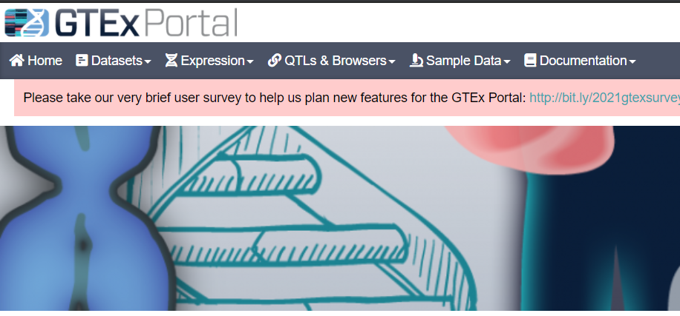
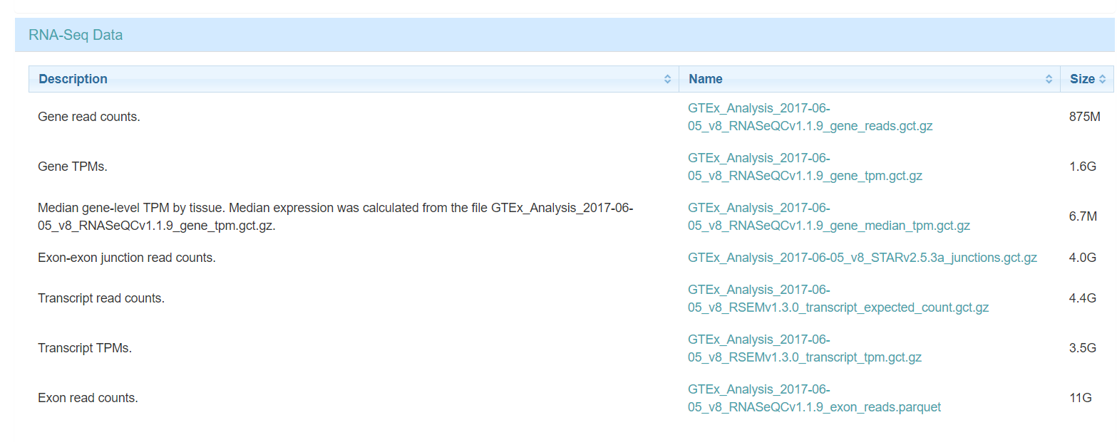
Dataset to be used
The Genotype-Tissue Expression (GTEx)

Slide 5
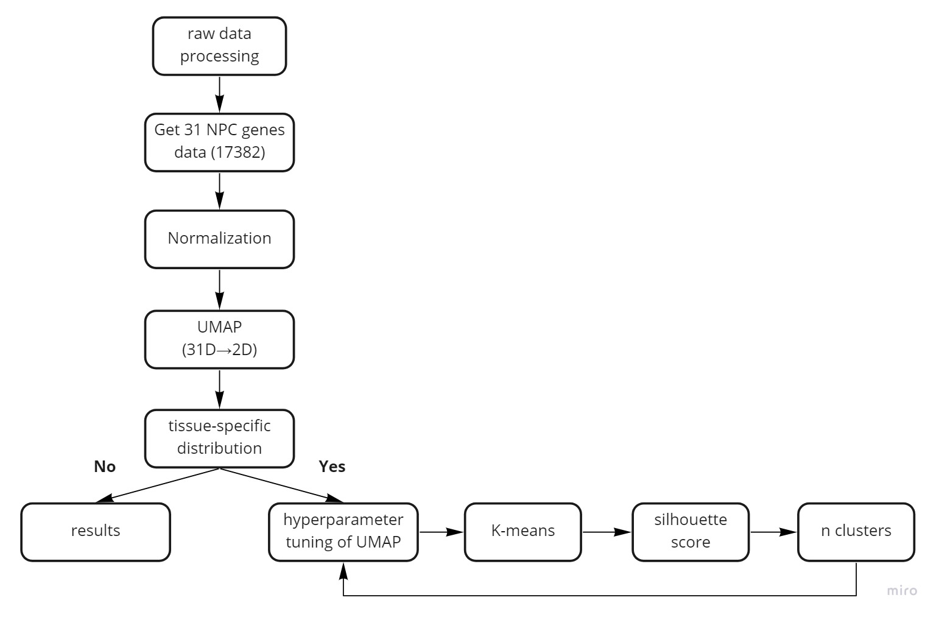
分析架構

Slide 6
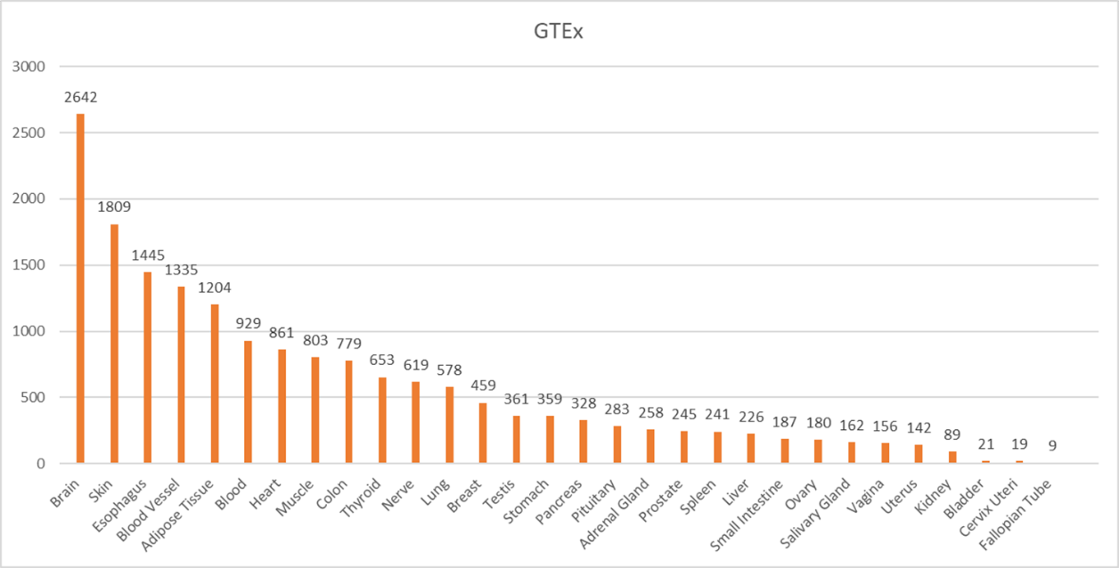
Data processing
Total:
30 tissues
17382 samples

Slide 7
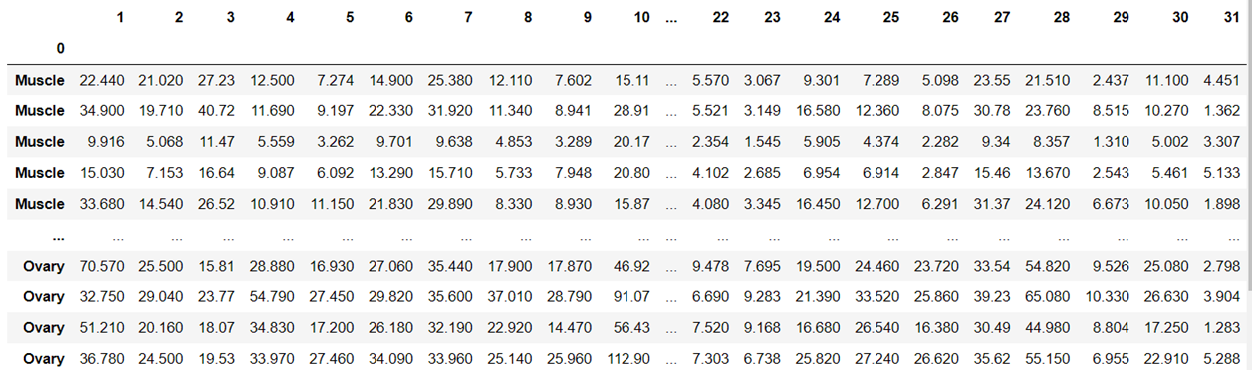
31 NPC genes

Slide 8
Normalization
 | Gene1 | Gene2 | … | Gene31
Sample 1 | 22.4 | 21 | … | 4.4
Sample 2 | 34.9 | 19.7 | … | 1.3
… | … | … | … | …
Sample 17381 | 51.2 | 20.1 | … | 1.2
Sample 17382 | 36.7 | 24.5 | … | 5.2
 | Gene1 | Gene2 | … | Gene31
Sample 1 | 0.05 | 0.047 | … | 0.01
Sample 2 | 0.064 | 0.036 | … | 0.002
… | … | … | … | …
Sample 17381 | 0.041 | 0.027 | … | 0.005
Sample 17382 | 0.032 | 0.032 | … | 0.001
Sum = 1
Normalization

Slide 9
Strategy
Defines who is your neighbors in high-dimensional space
Reconstruction in low-dimensional space

Slide 10
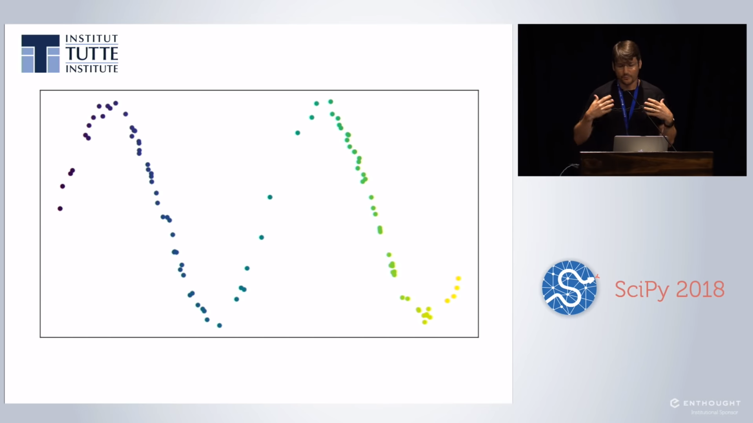

Slide 11
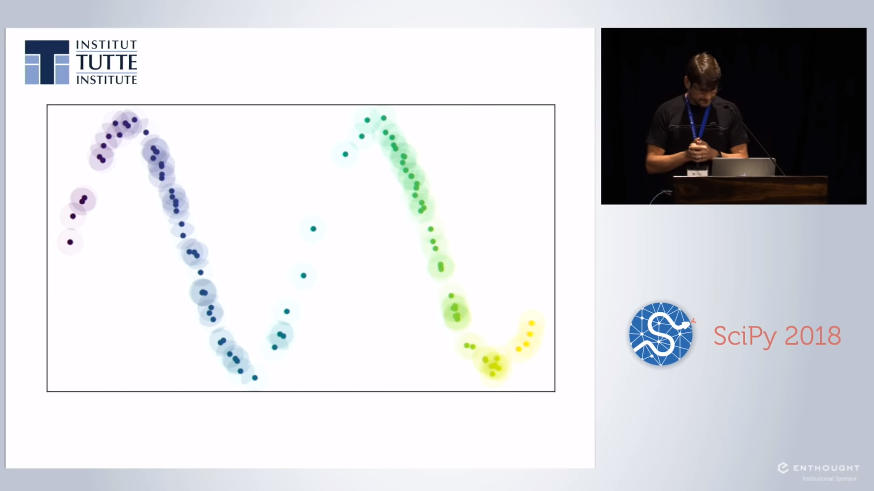

Slide 12
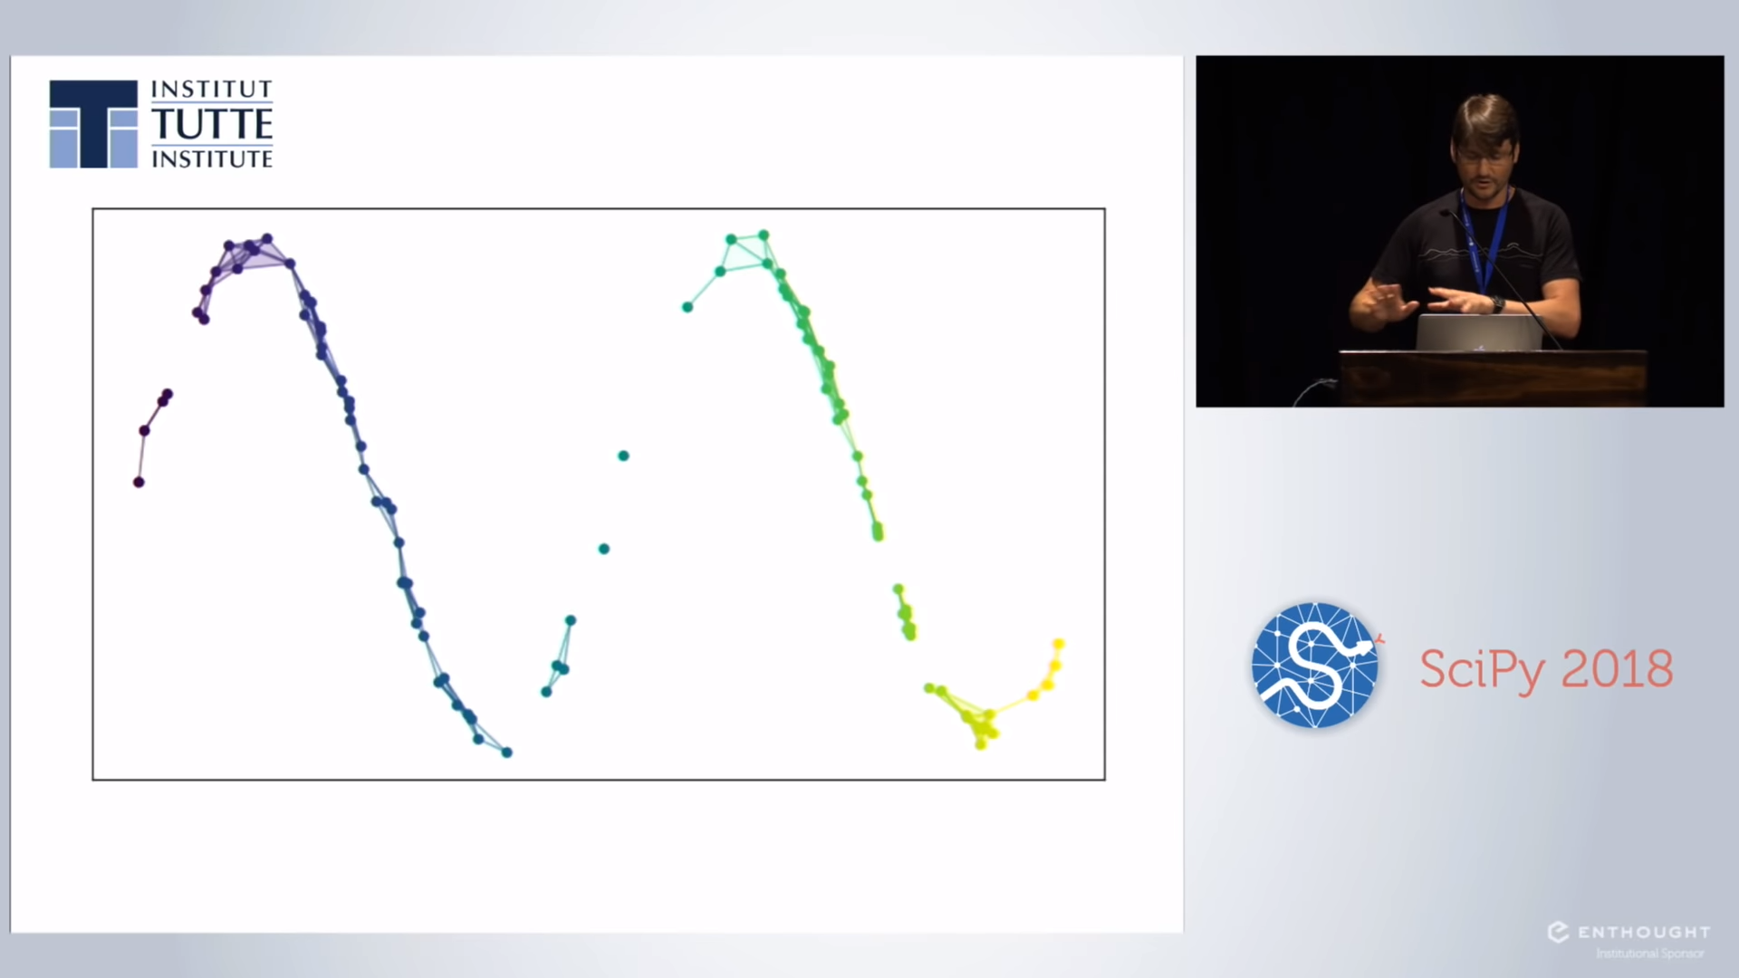

Slide 13
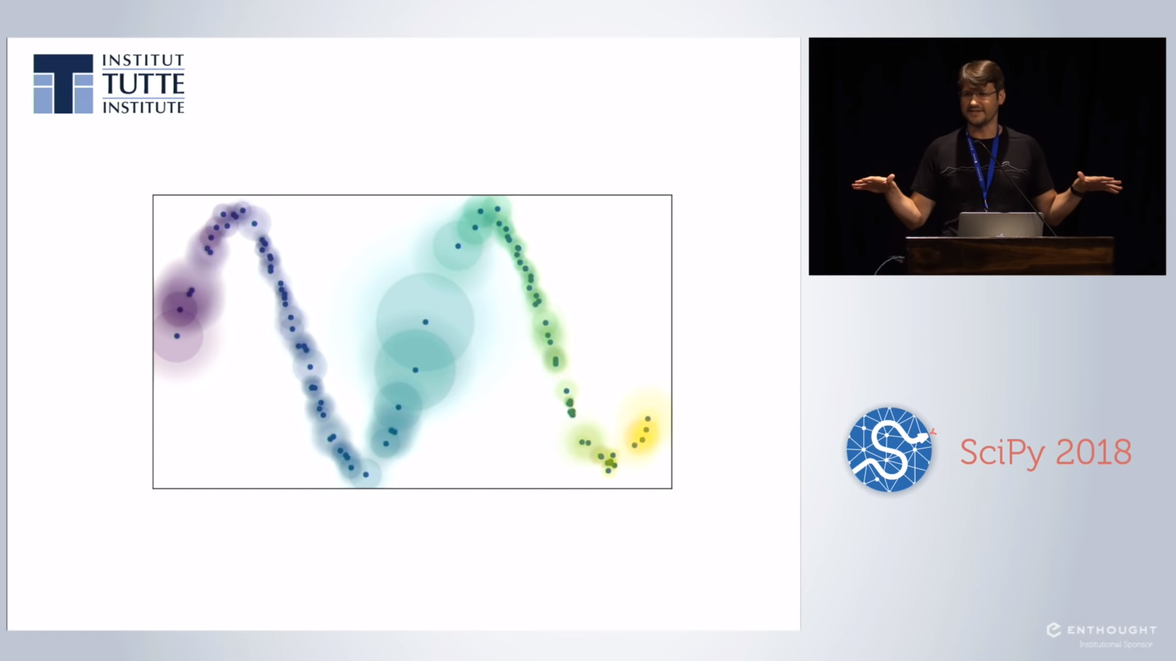

Slide 14
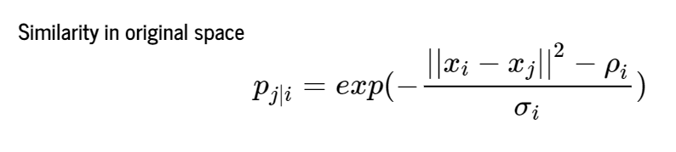
Uniform Manifold Approximation and Projection (UMAP)
ρi： Xi與最近鄰居的距離
Mannifold：歐幾里得空間中的曲線、曲面等概念的推廣

Slide 15
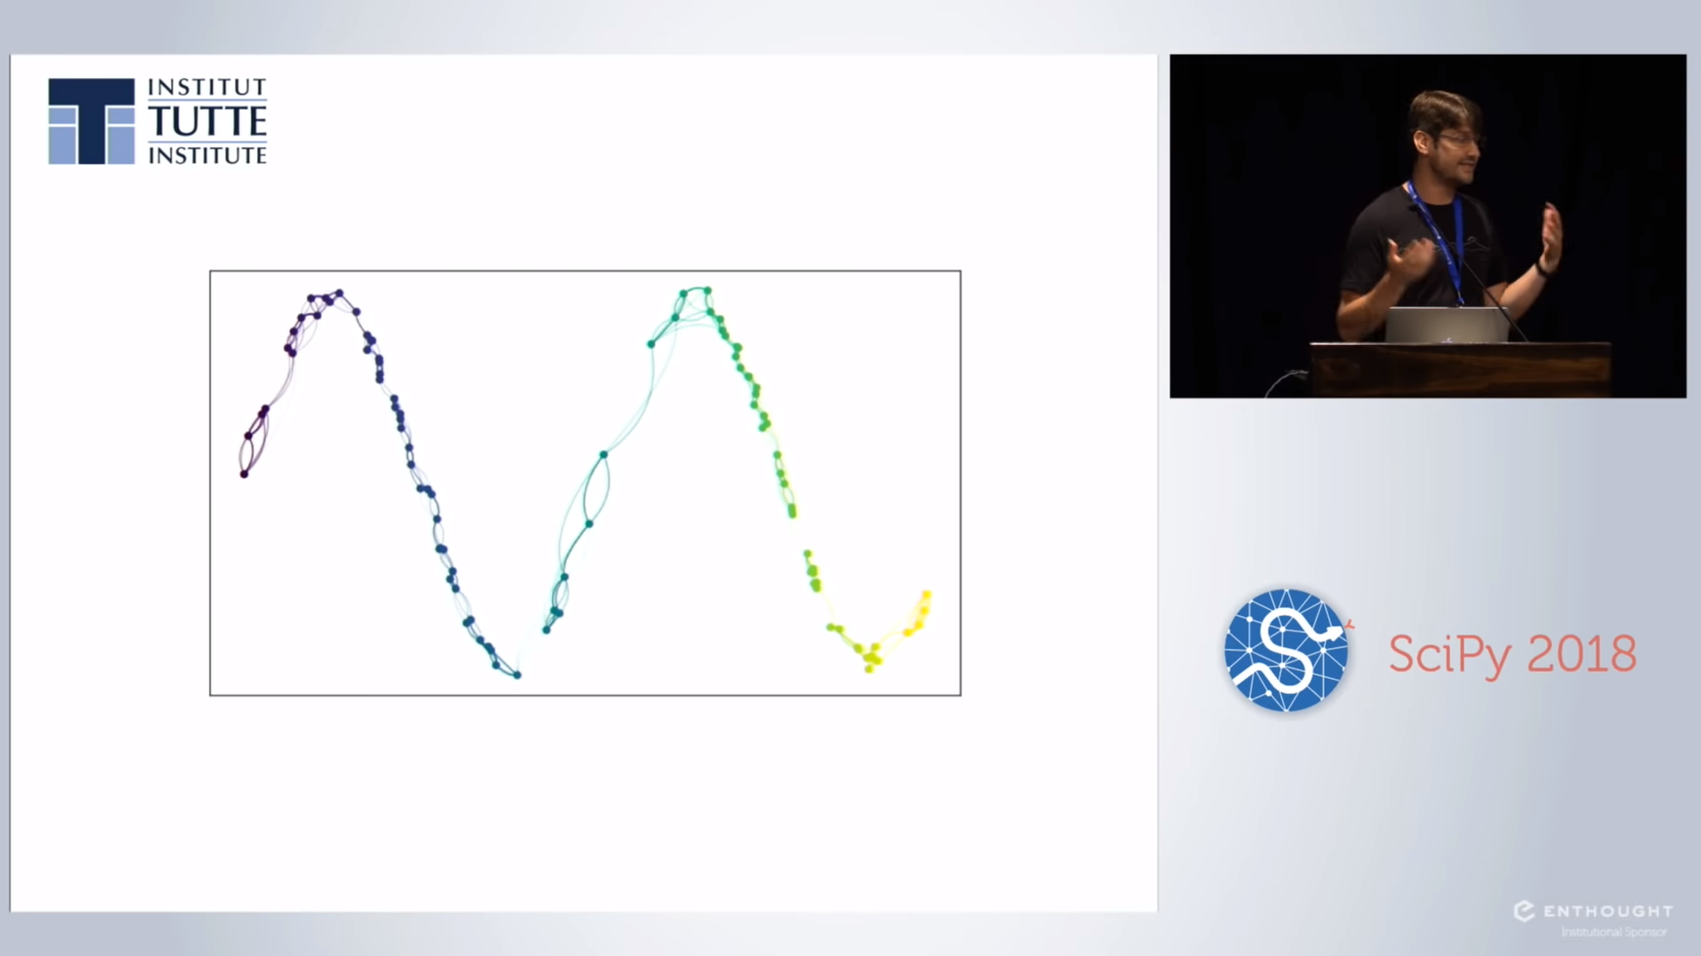

Slide 16
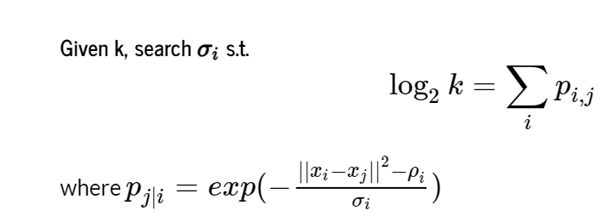
k-nearest neighbor(KNN) graph construction

Slide 17
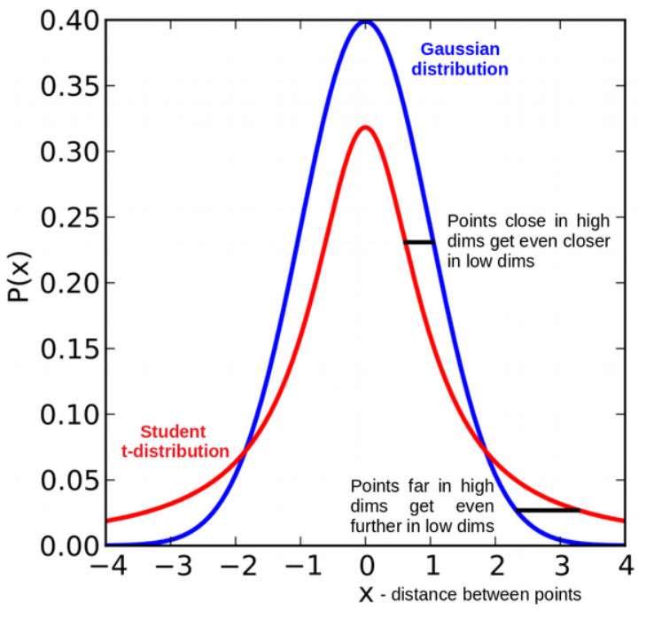
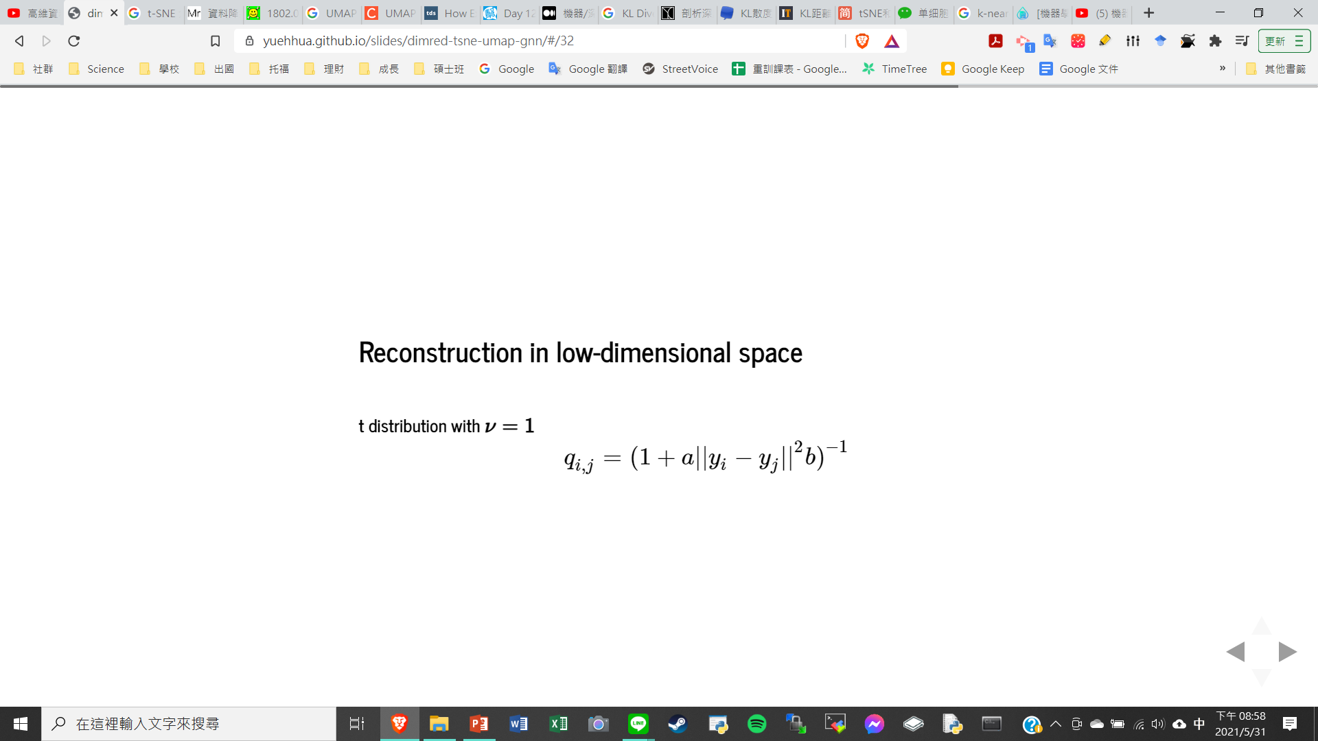
Reconstruction in low-dimensional space
a≈1.93 and b≈0.79 for default UMAP hyperparameters

Slide 18
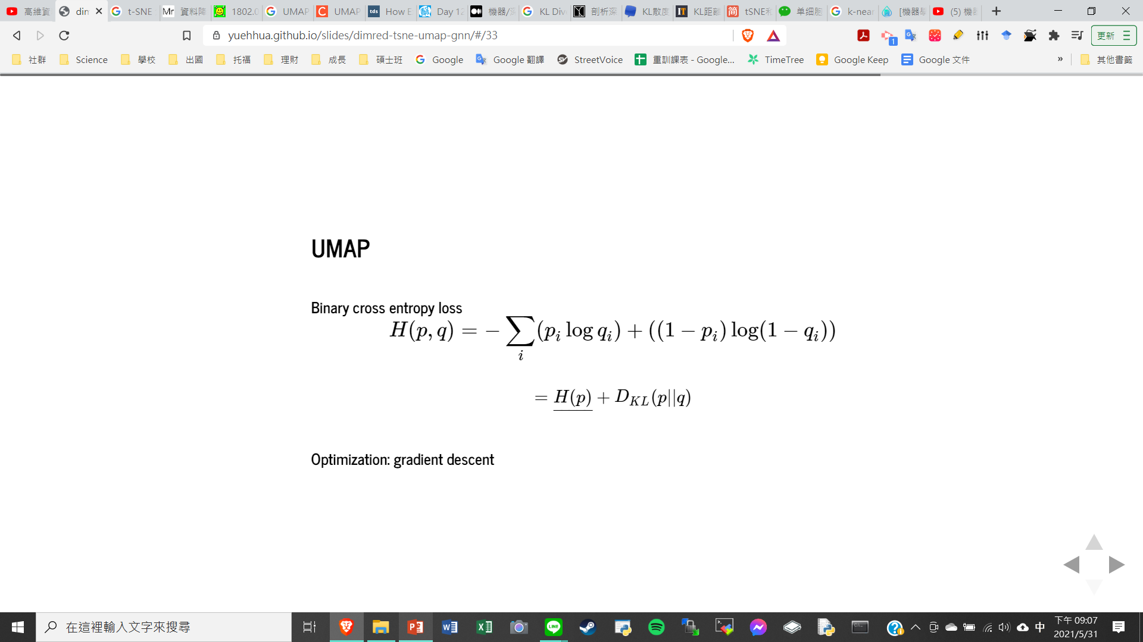
Binary cross entropy loss

Slide 19
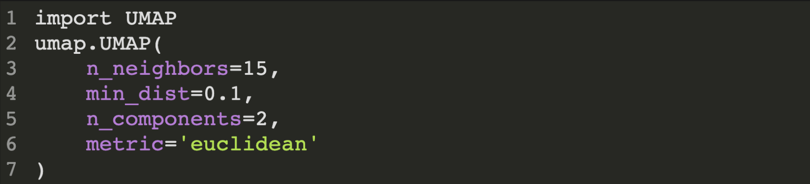
INTRODUCTION OF HYPERPARAMETERS IN UMAP

Slide 20
• n_neighbors - the number of neighbors - balance local v.s. global structure - range from 2 to 200
•min_dist - minimum distance to apart points - compactness of all points distribution - range from 0.0 to 0.99
• n_components - determine dimensionality of reduced dimensions - usually set as 1 or 3
• metric - enclidean, manhattan, chebyshev, minkowski, canberra, braycurtis, haversine, mahalanobis, cosine, hamming…

Slide 21
UMAP IMPLEMENTATION AND INTERPRETATION

Slide 22
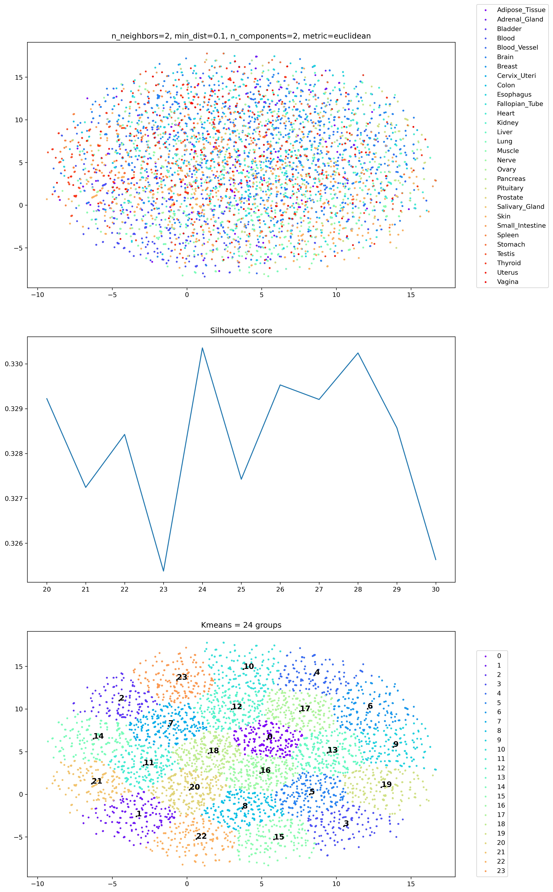
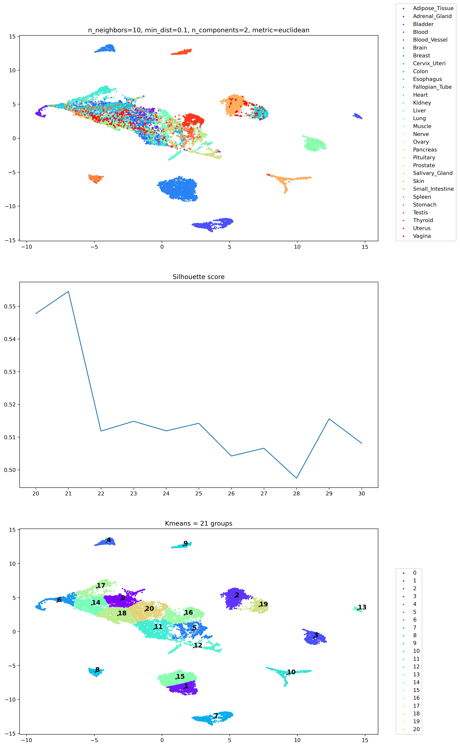
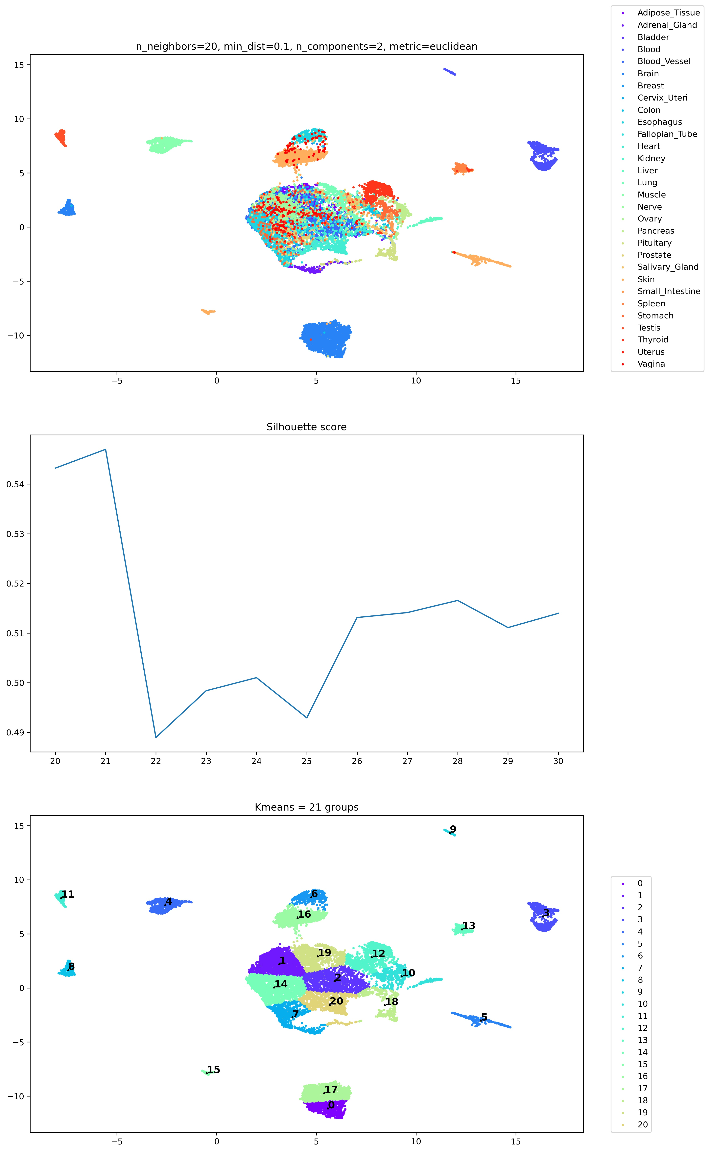
n_neighbors

Slide 23
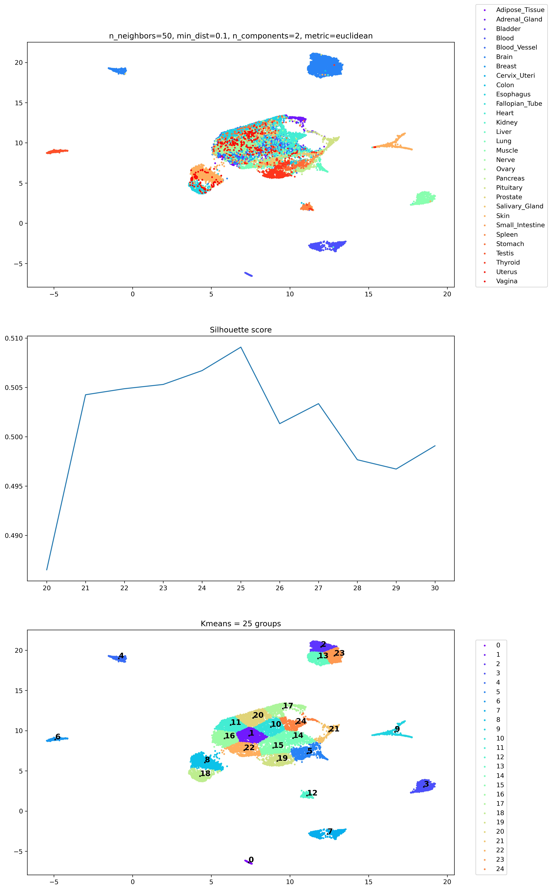
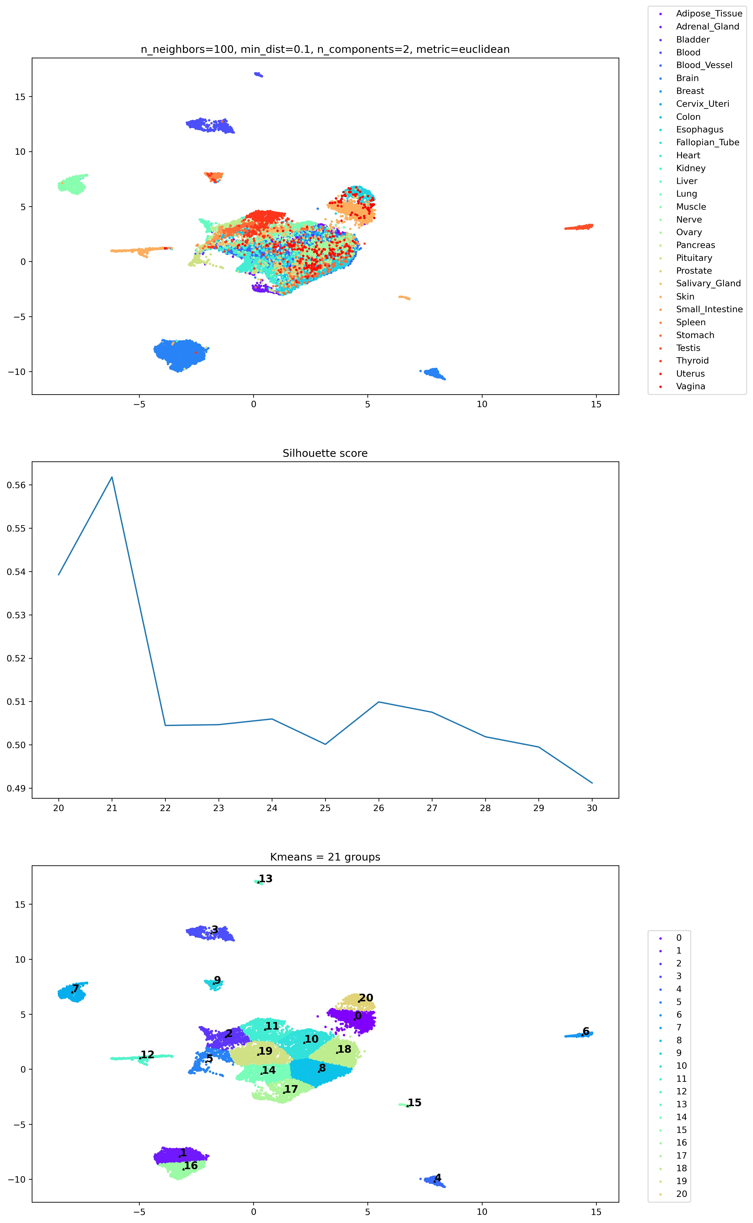
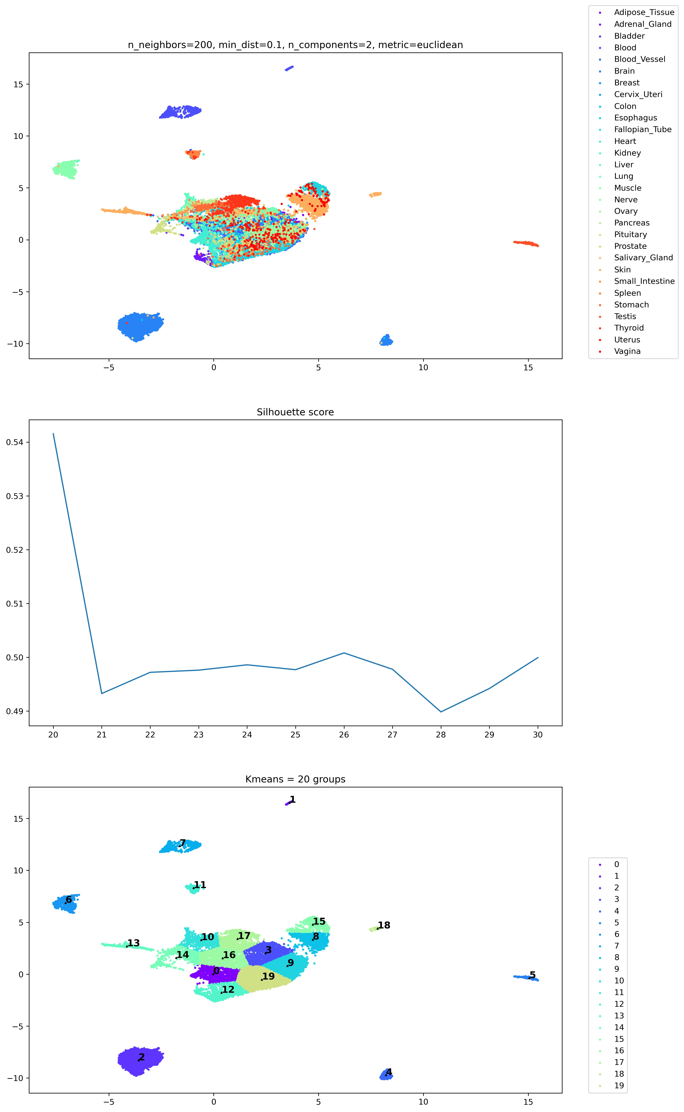
n_neighbors

Slide 24
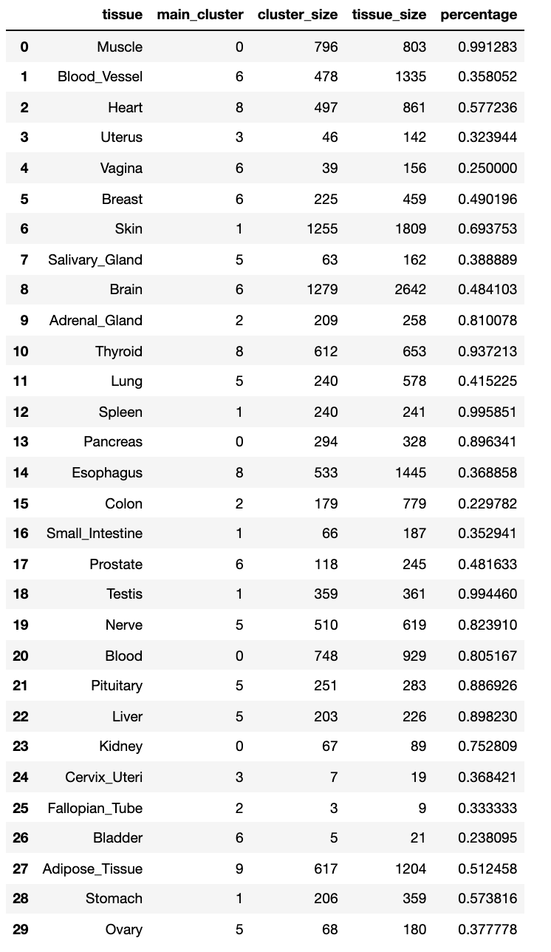
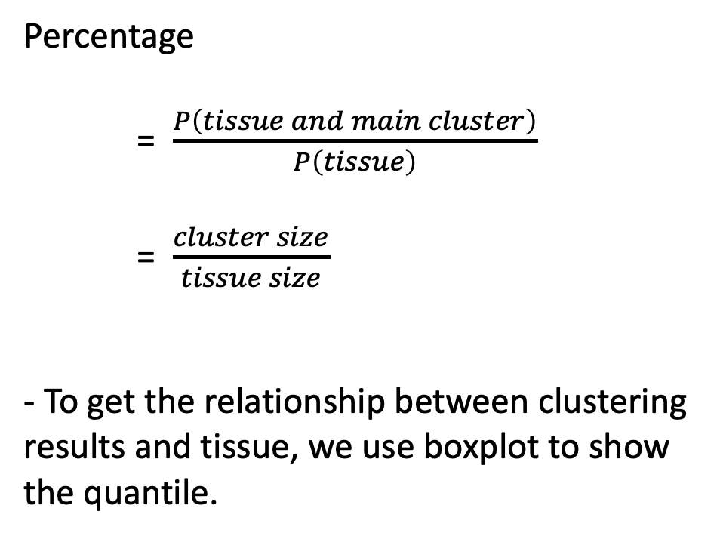
Cluster results mapping to tissue classifications
Percentage
= $\frac{P\left(tissue and main cluster\right)}{P\left(tissue\right)}$
= $\frac{cluster size}{tissue size}$
- To get the relationship between clustering results and tissue, we use boxplot to show the quantile.

Slide 25
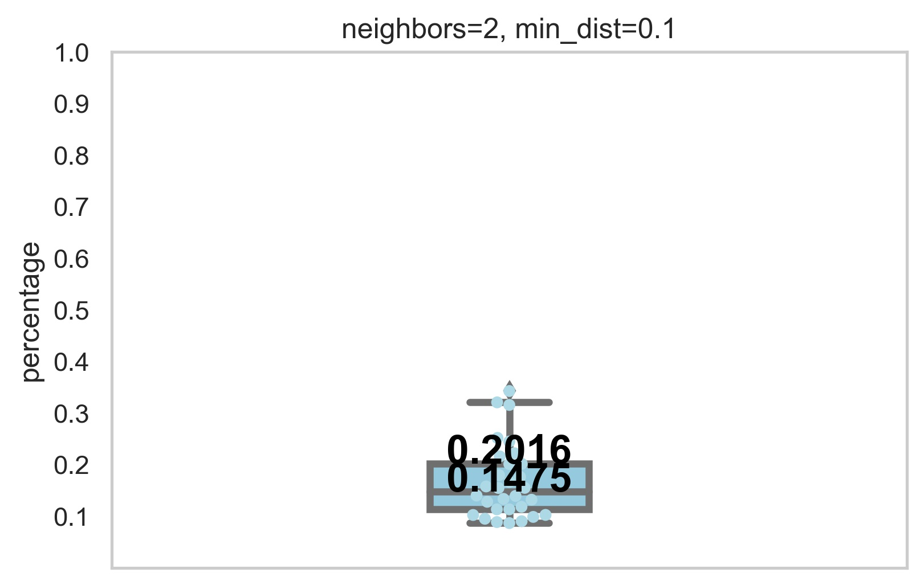
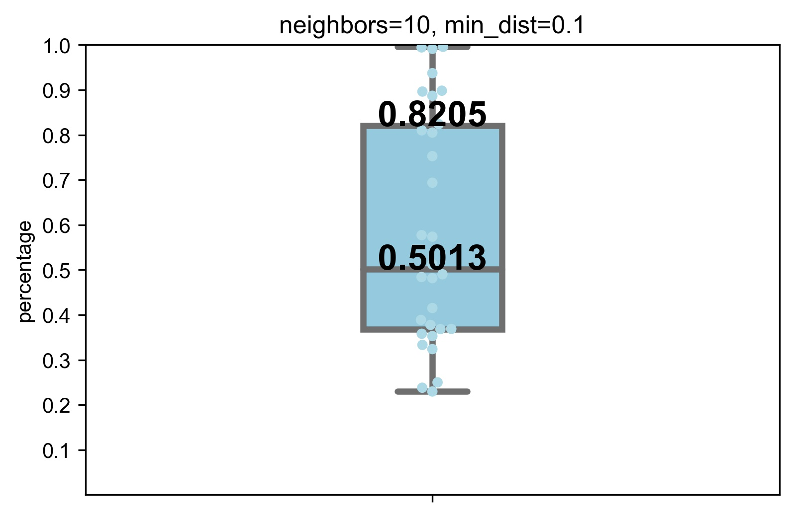
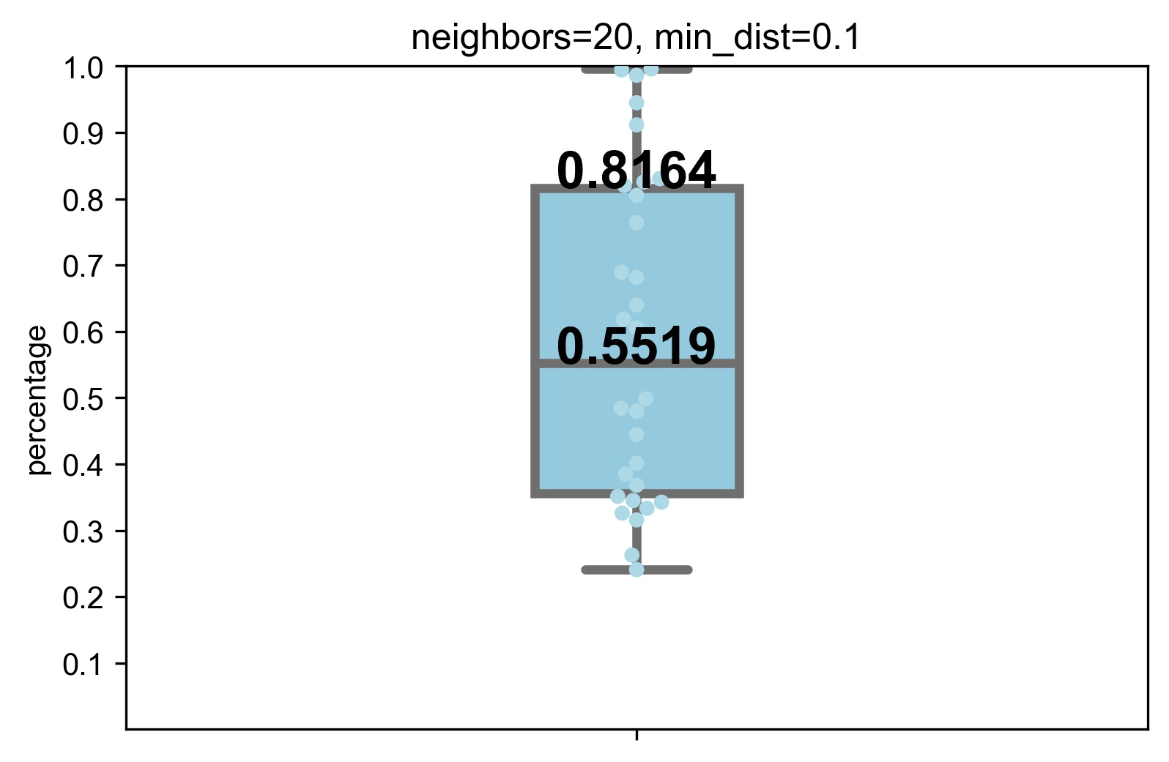
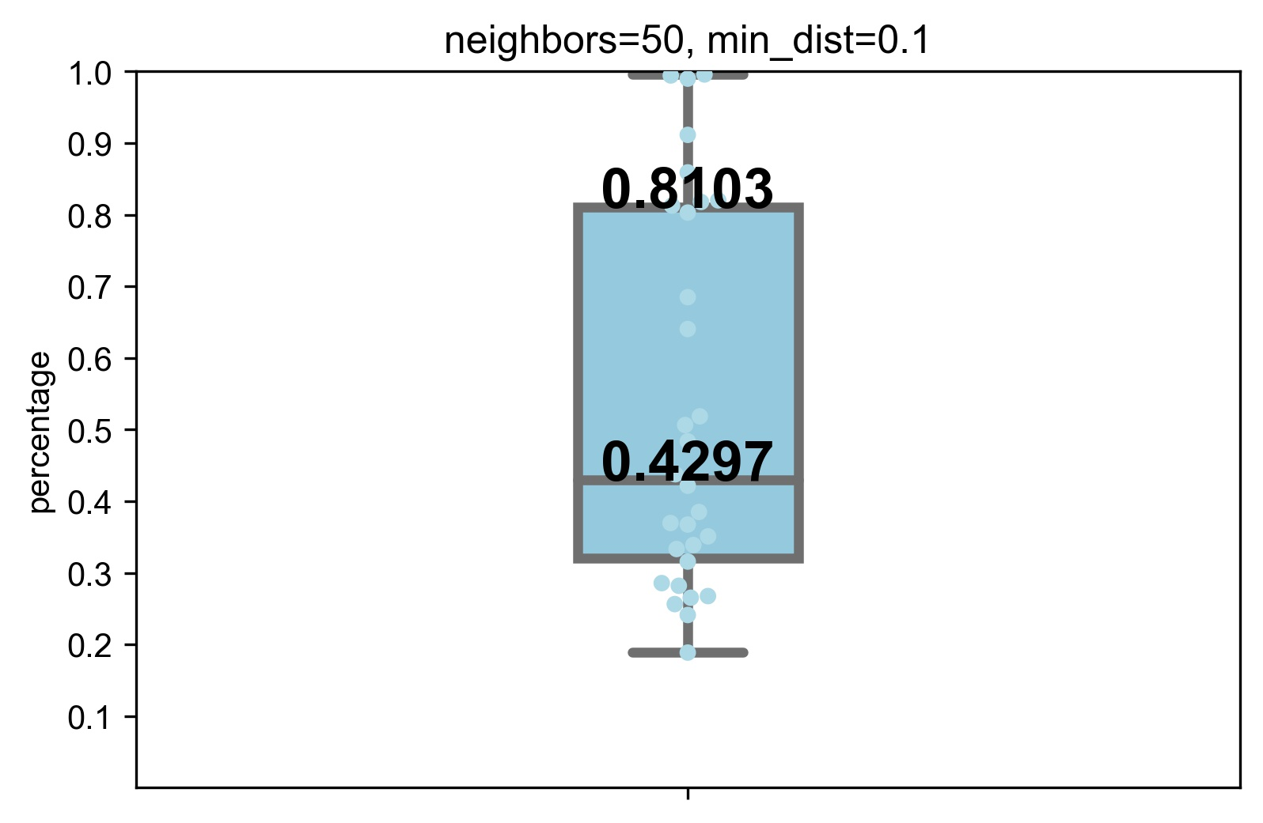
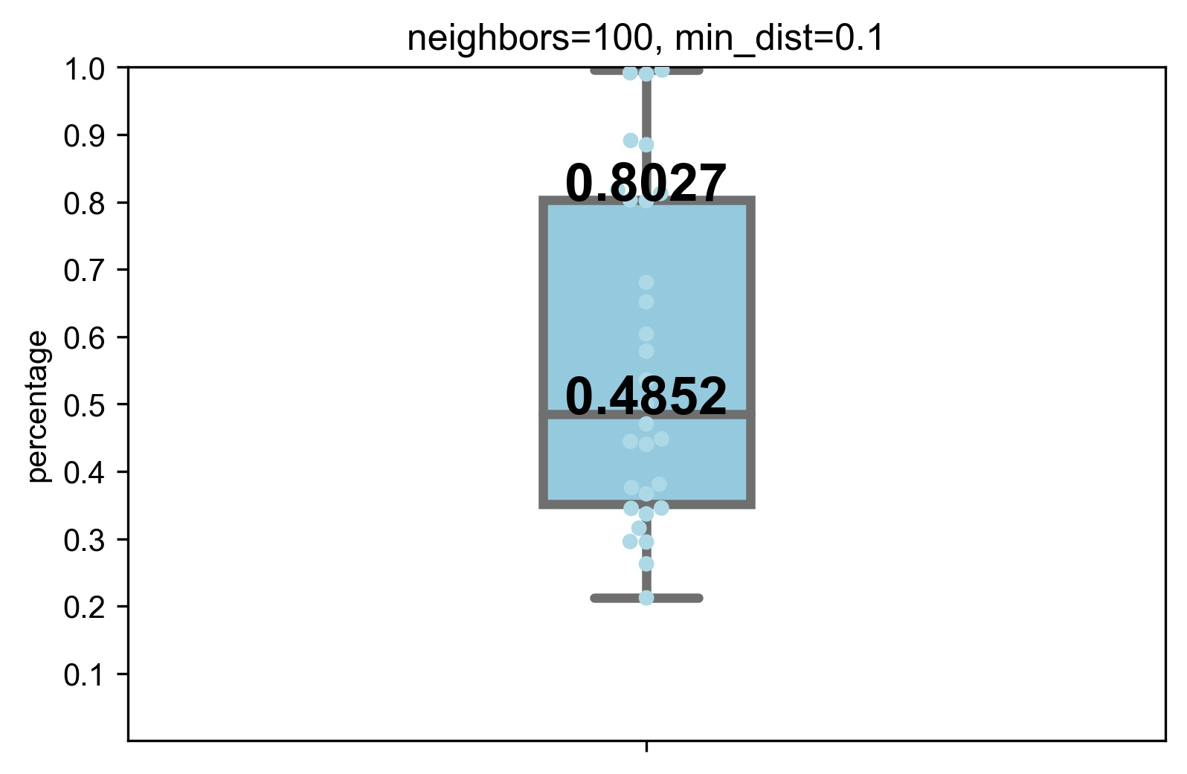

Cluster results mapping to tissue classifications

Slide 26
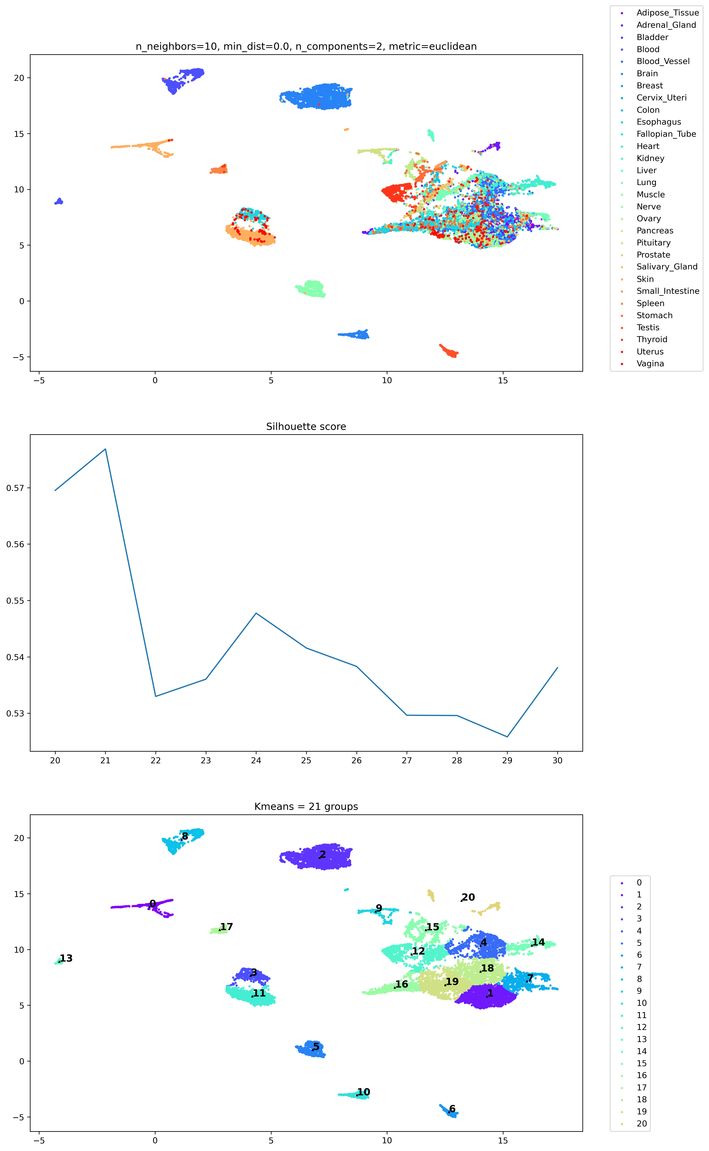
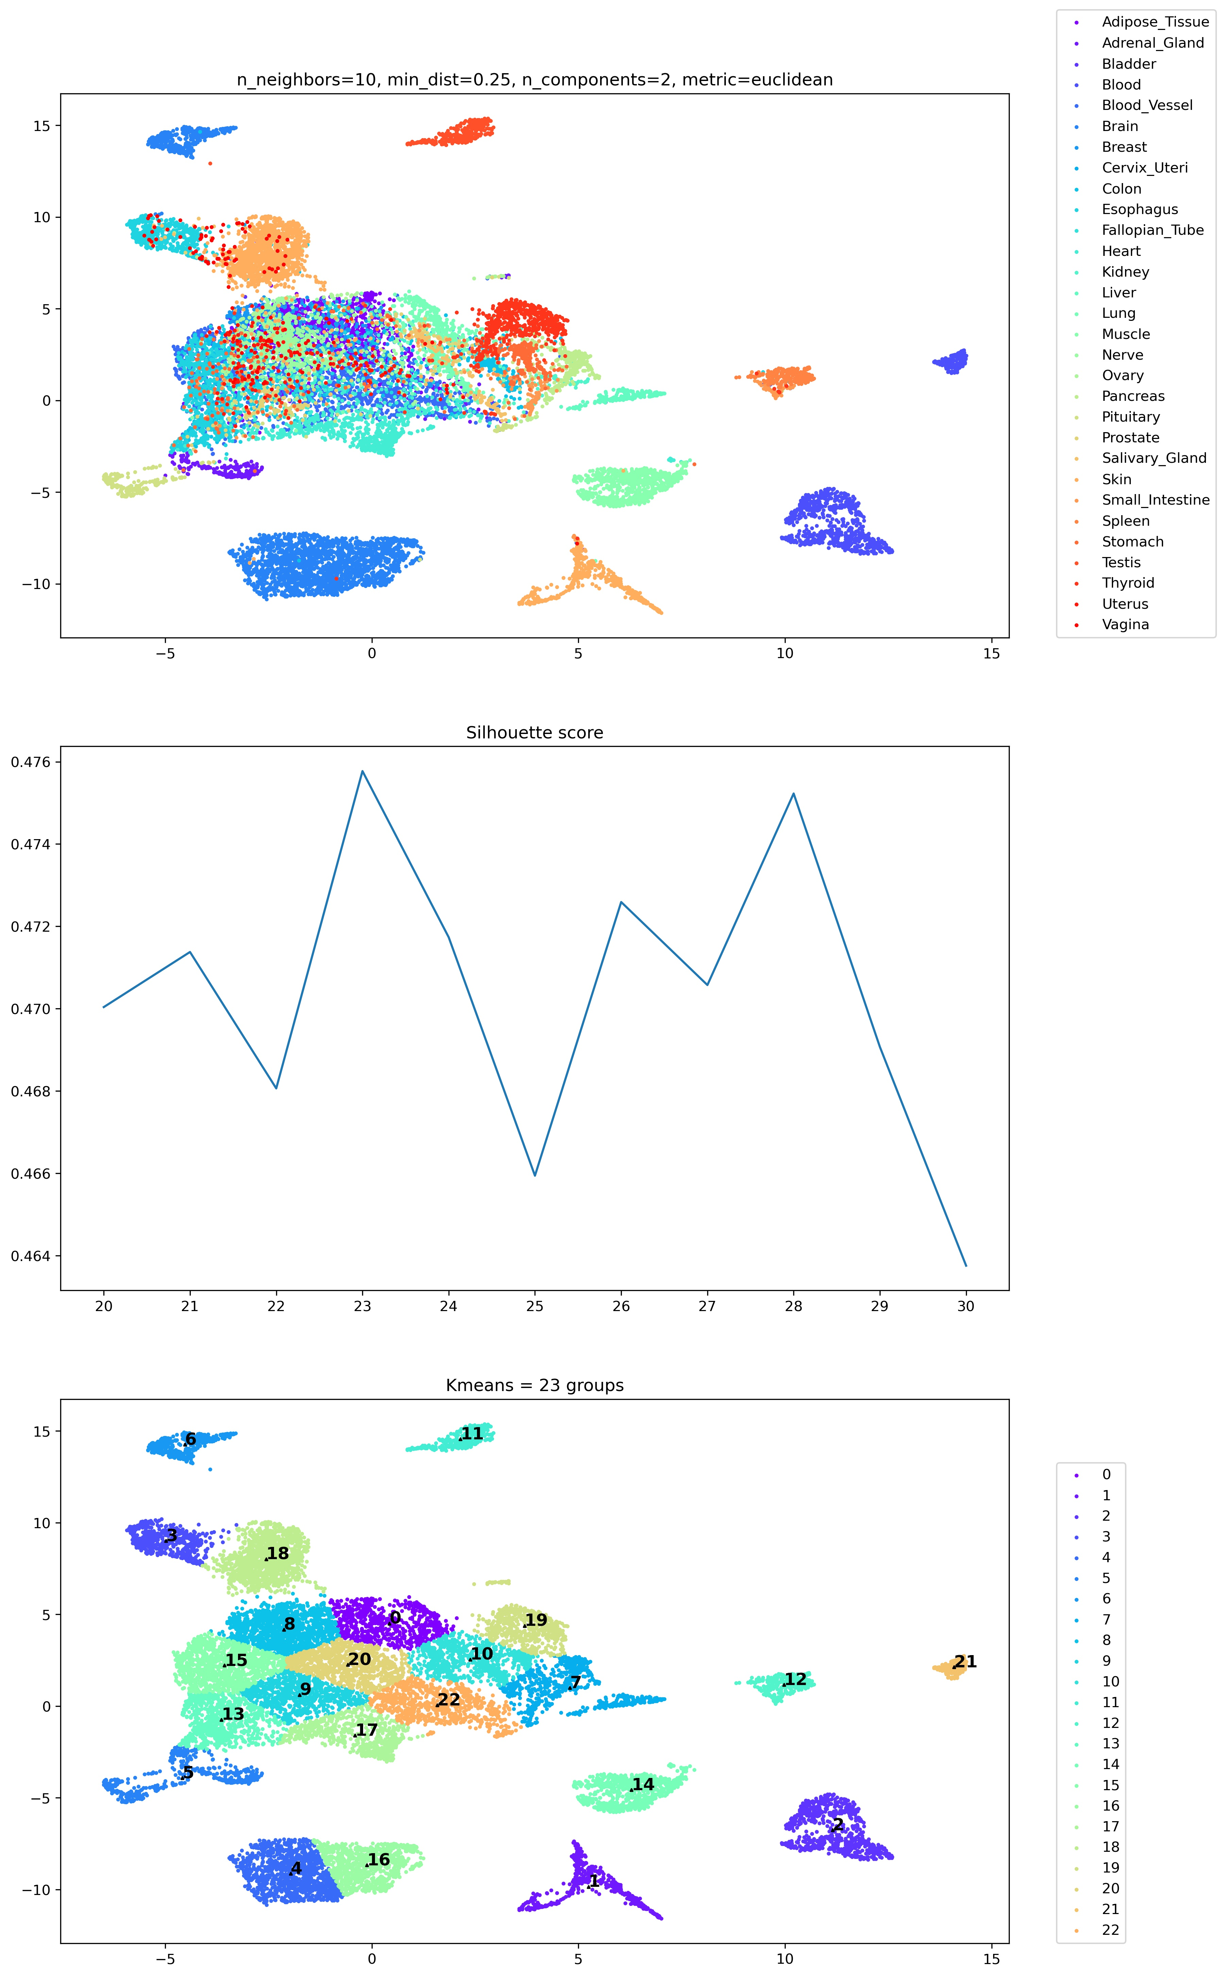
min_dist

Slide 27
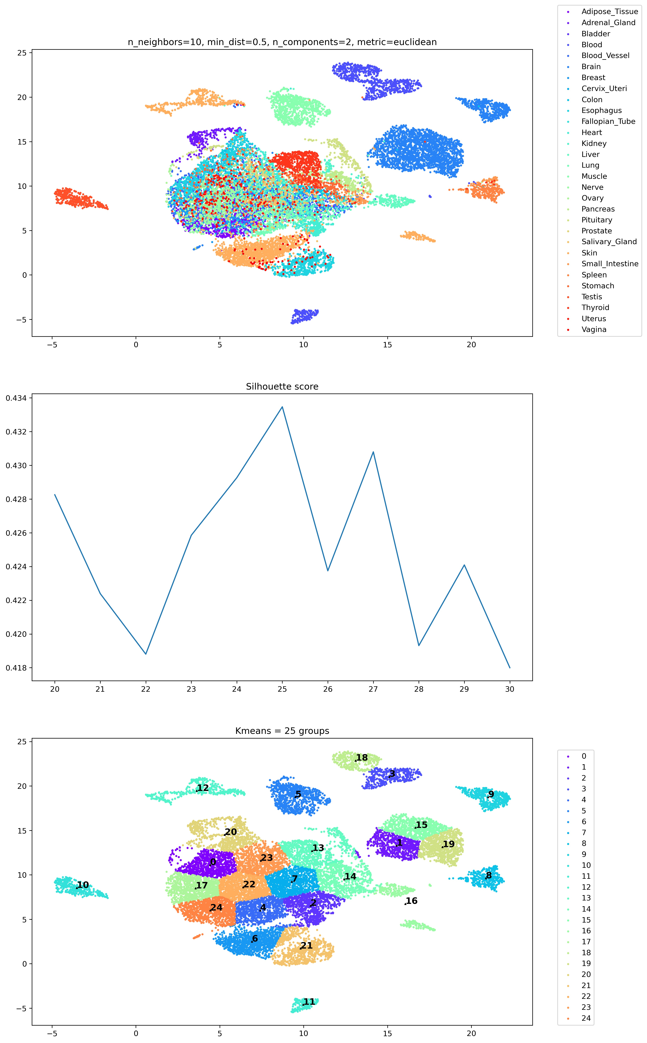
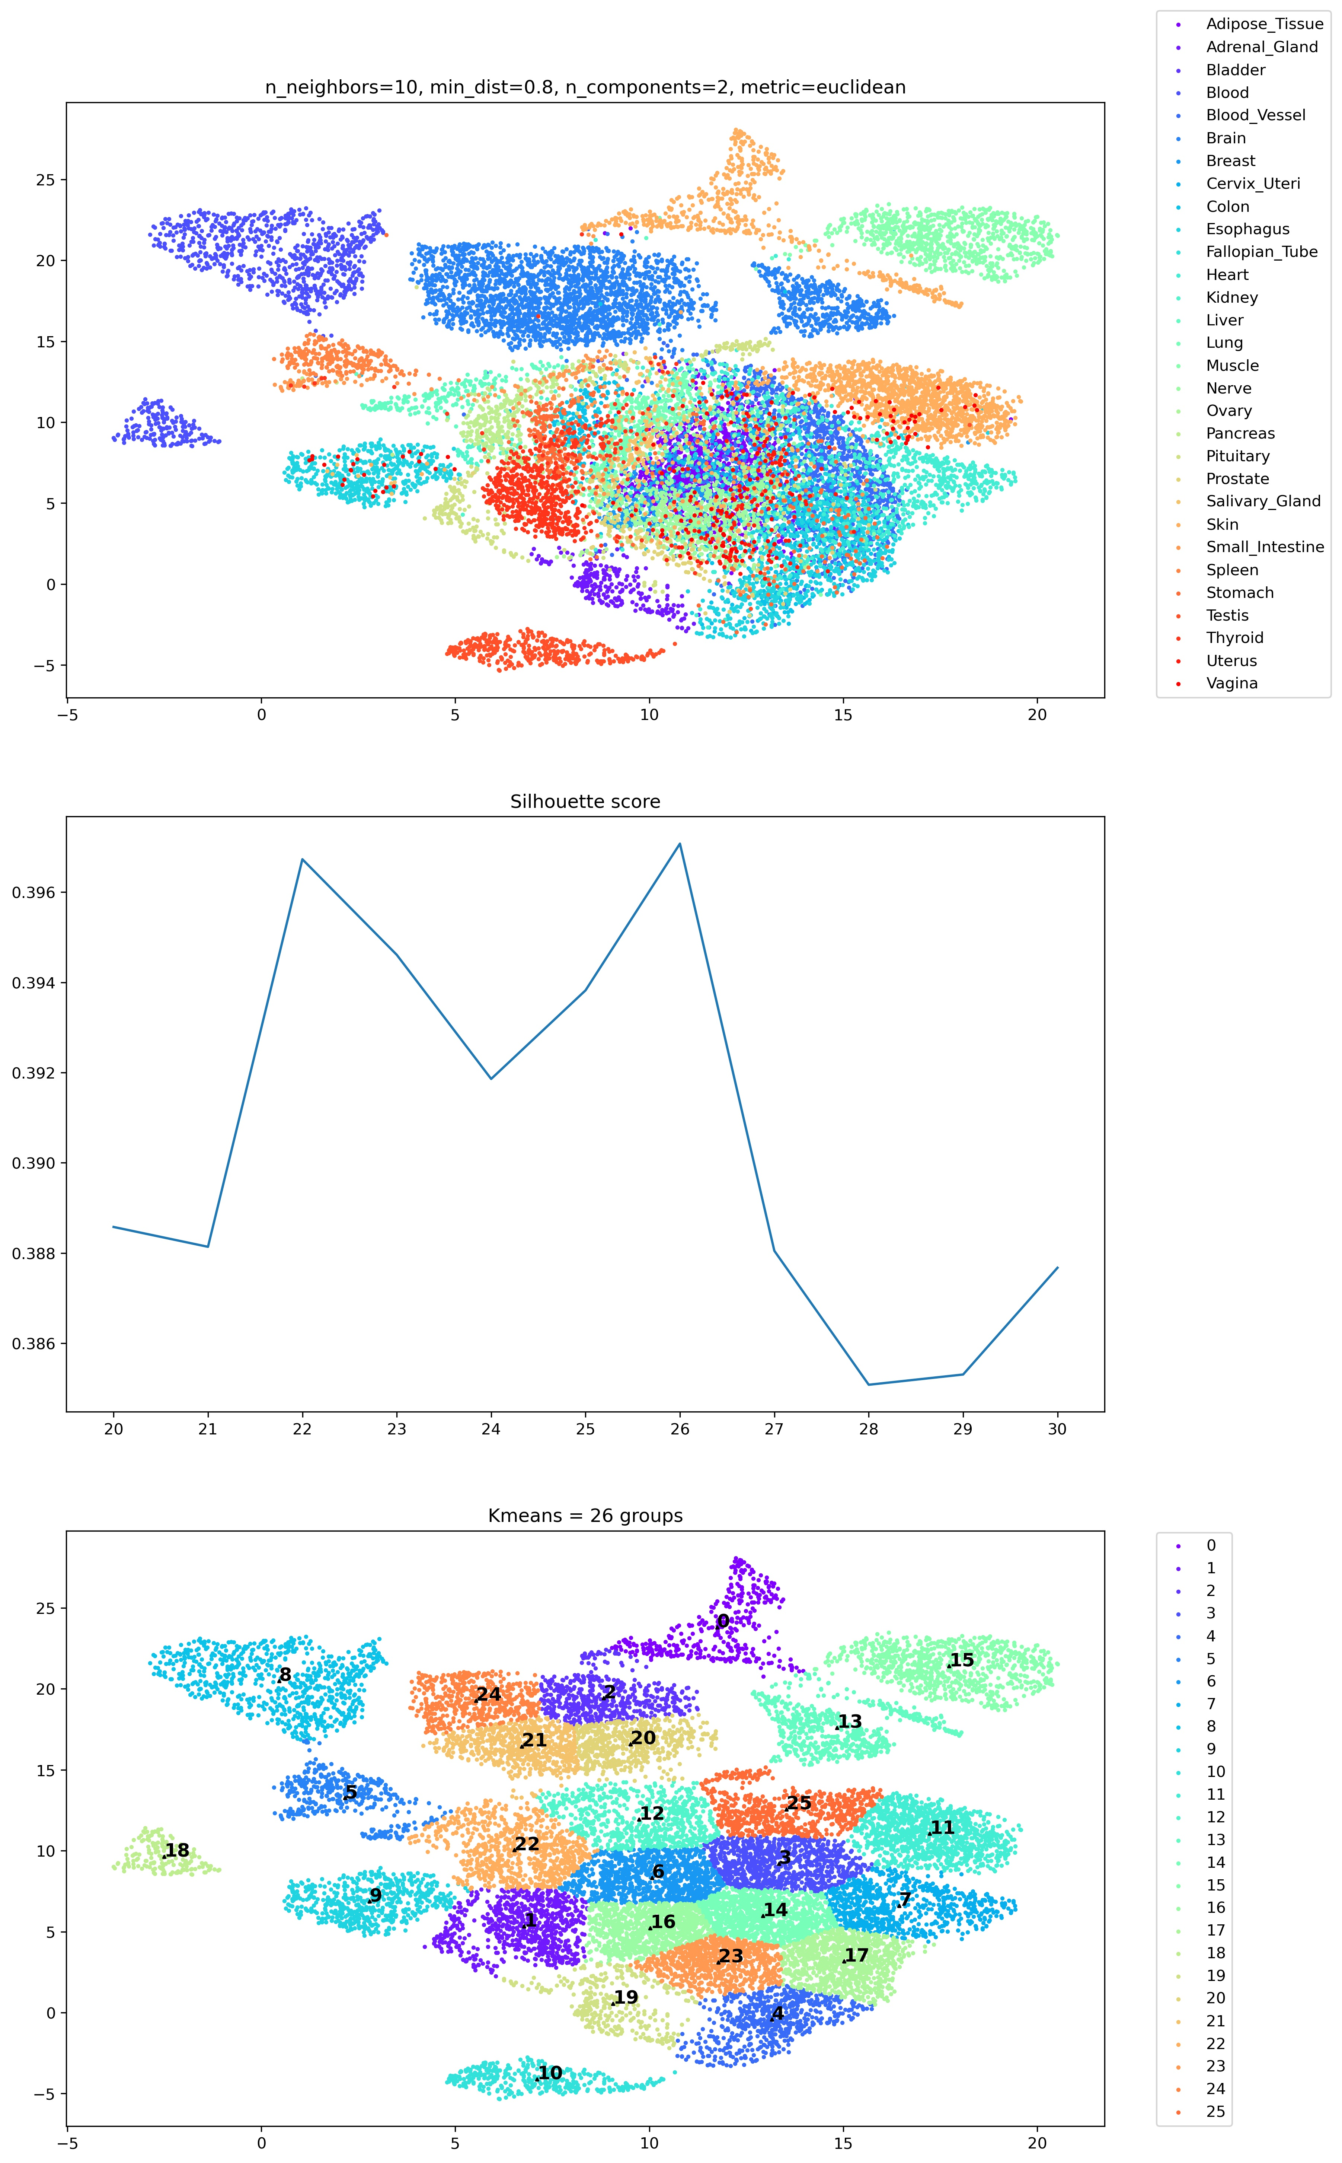
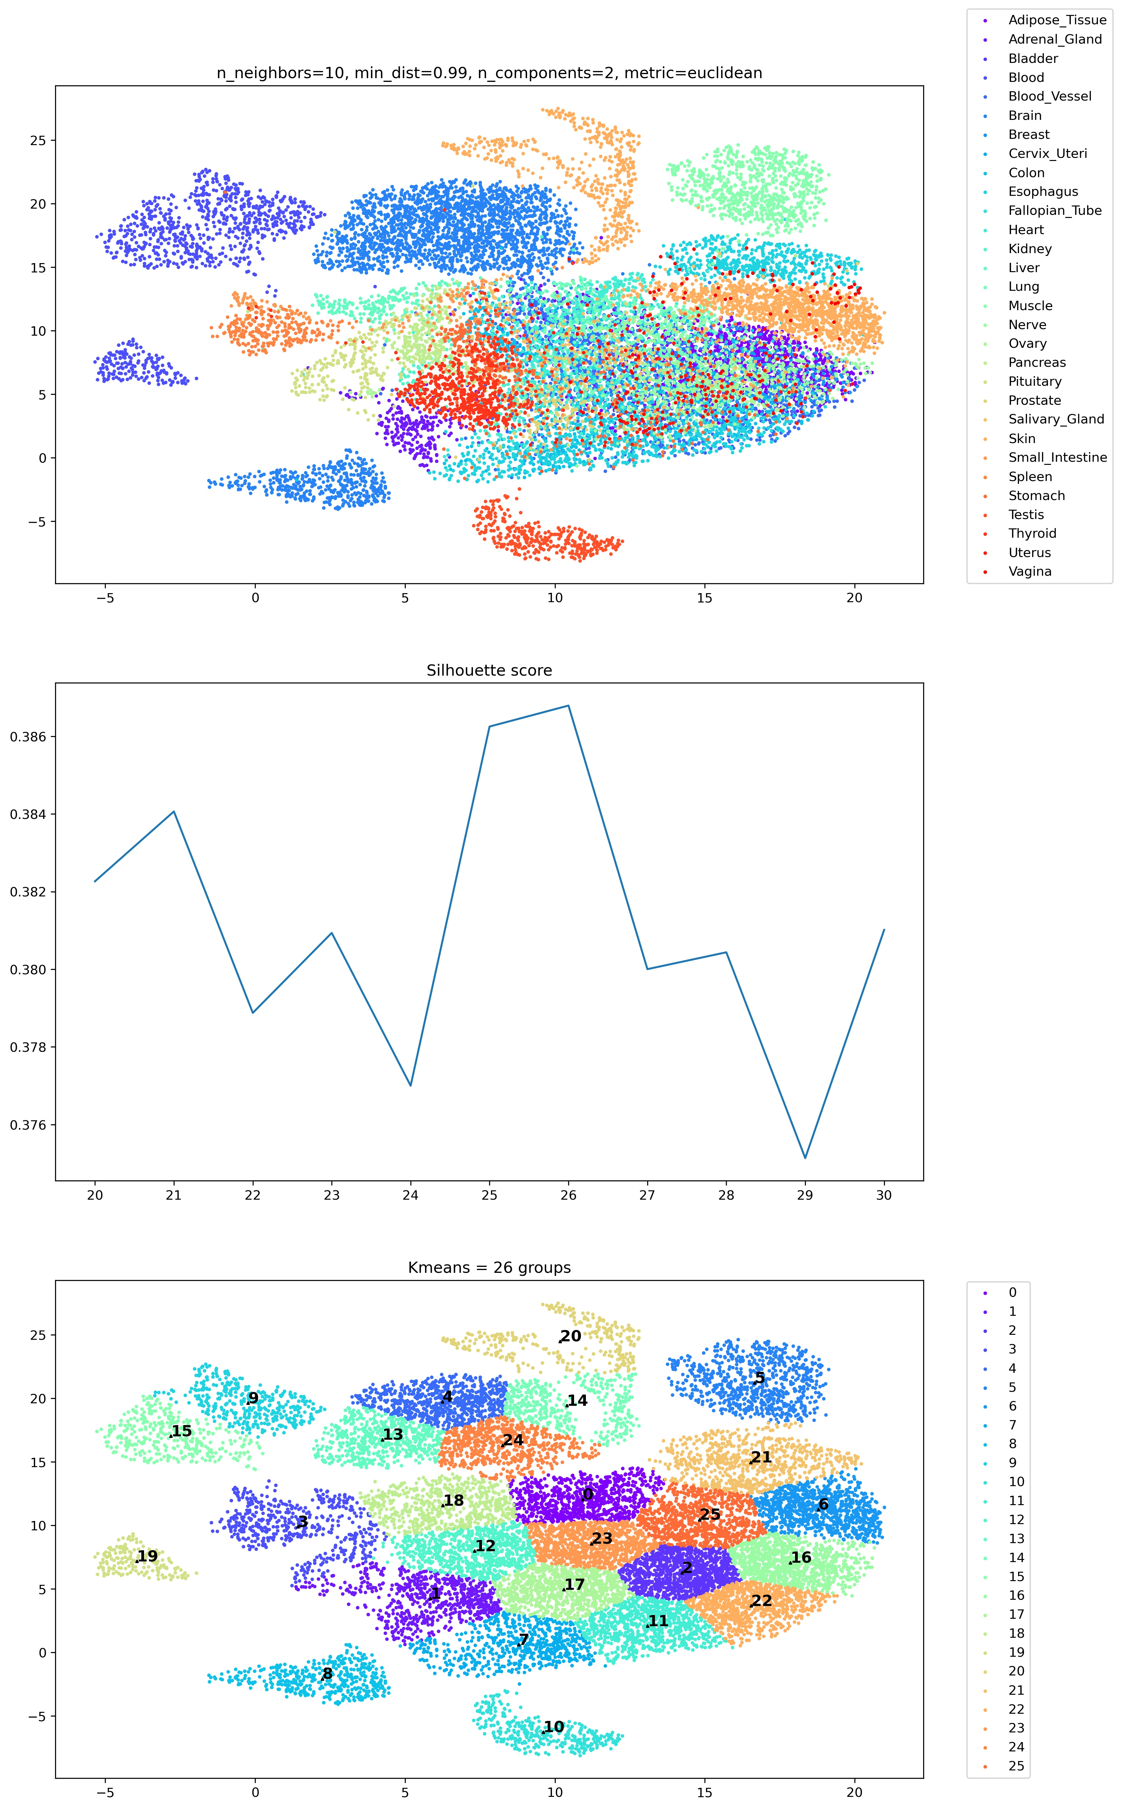
min_dist

Slide 28
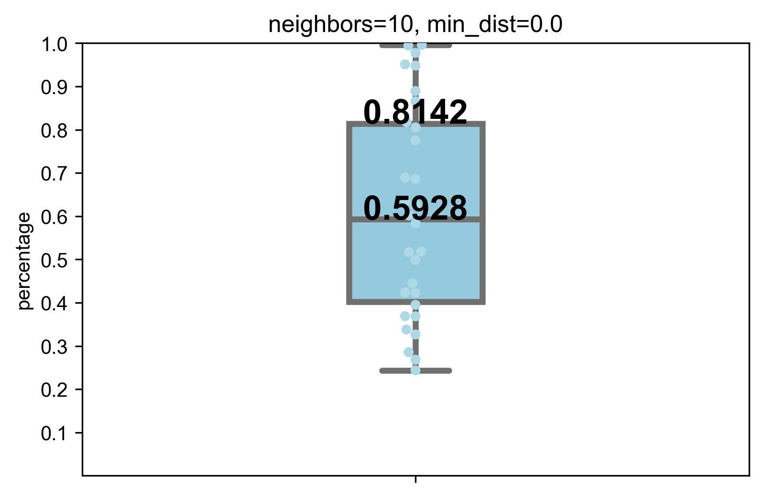

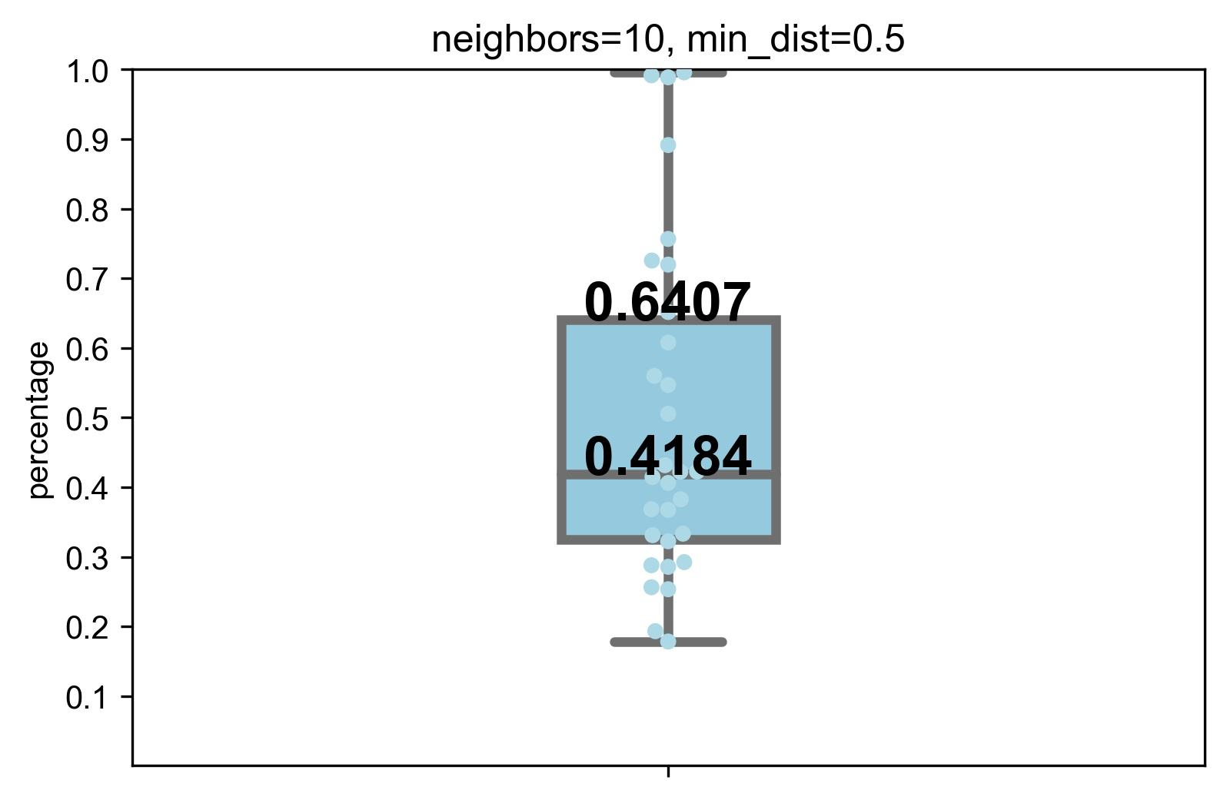
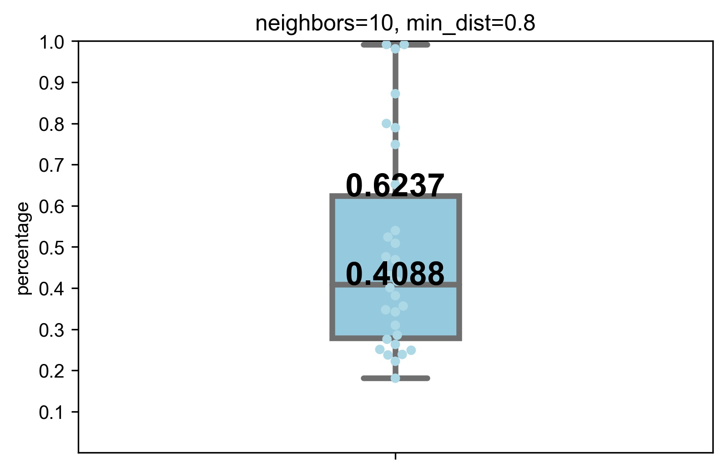
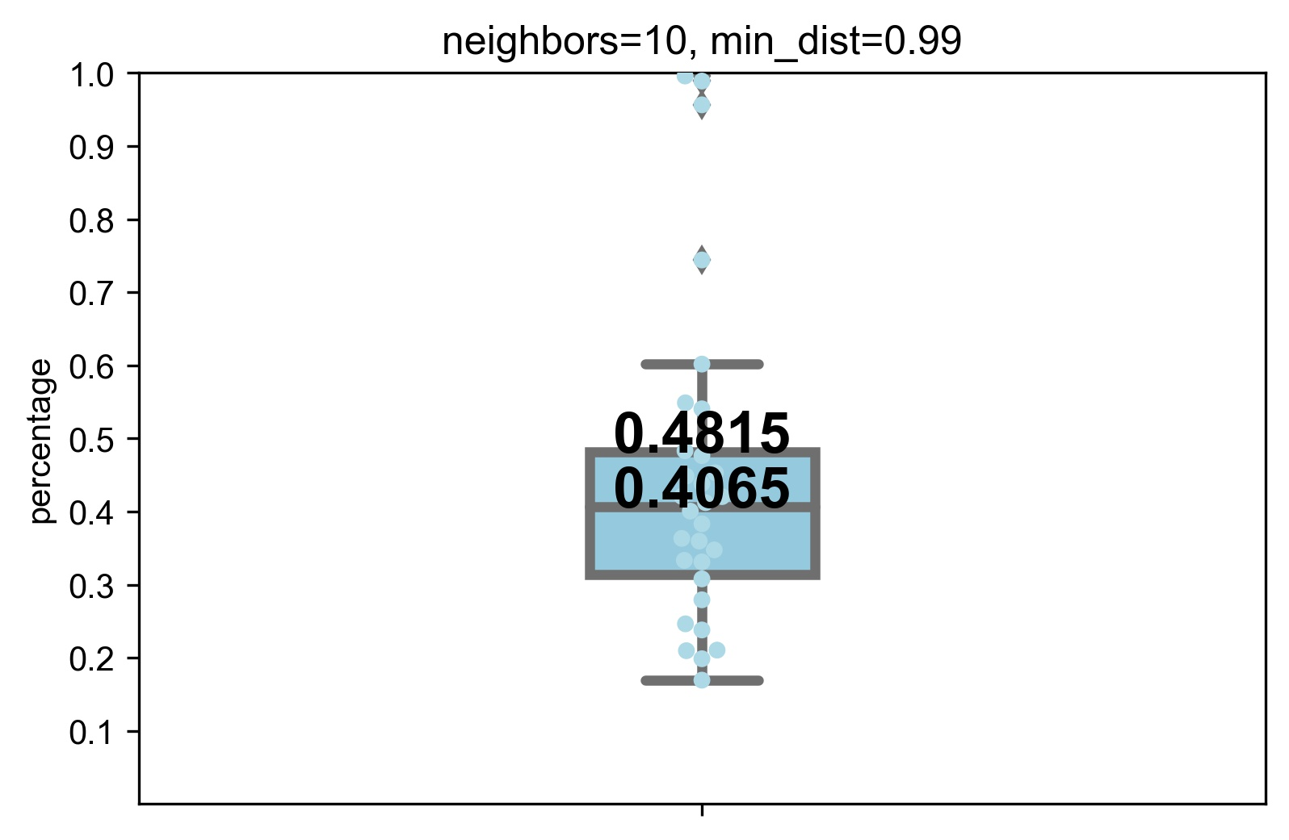
Cluster results mapping to tissue classifications

Slide 29

Optimized hyperparameters

Slide 30
Results of tissue-specific distribution
Tissue-specific | No tissue-specific
Spleen Testis Muscle Thyroid Liver Pancreas Pituitary Nerve
Blood vessel
Heart
Uterus
Vagina
Breast
Skin
Salivary gland
Brain
Adrenal gland
Lung
Esophagus
Colon
Small intestine
Prostate
Blood
Kidney
Cervix uteri
Fallopian tube
Bladder
Adipose tissue
Stomach
Ovary

Slide 31
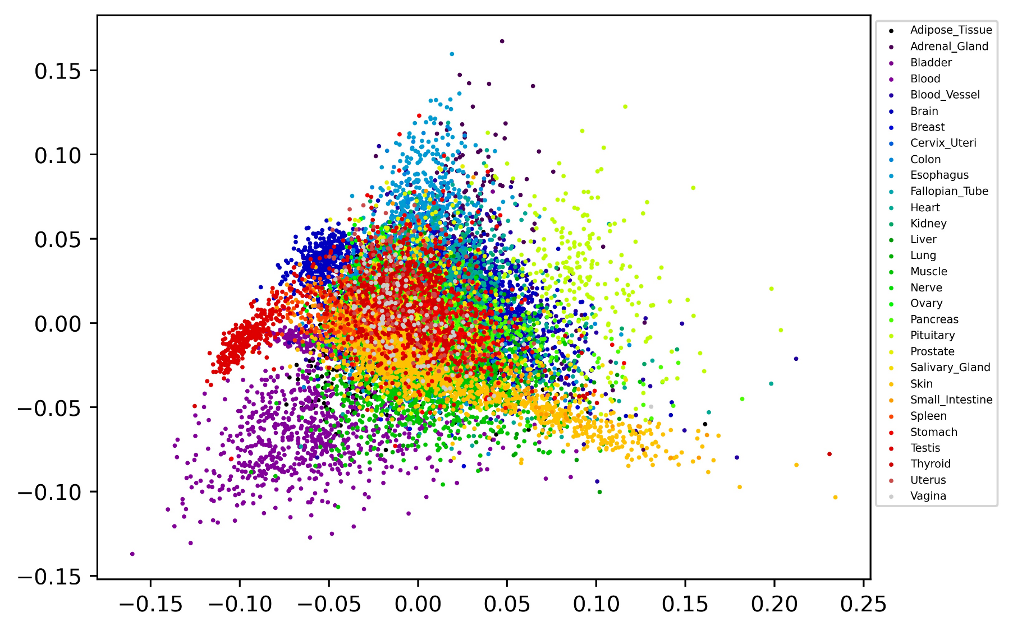
PCA

Slide 32
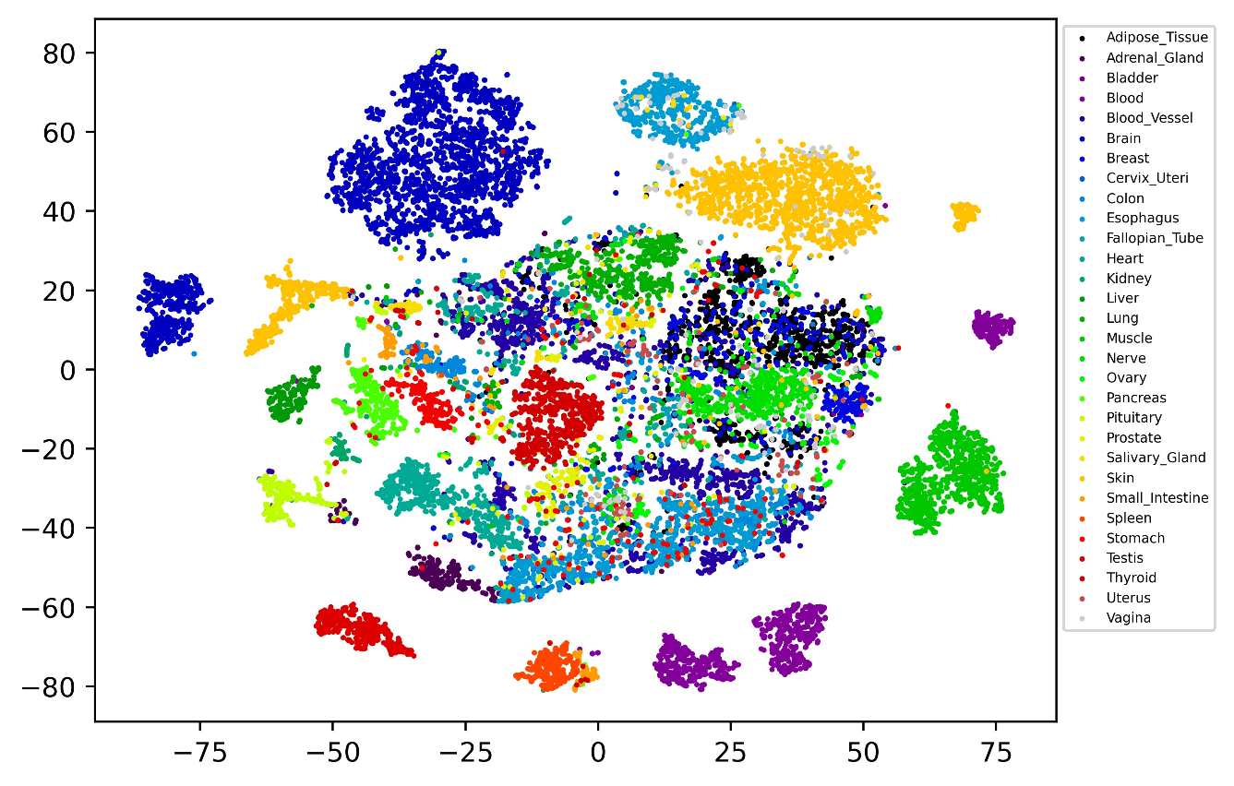
t-SNE

Slide 33
Thanks for listening

